Slide 1
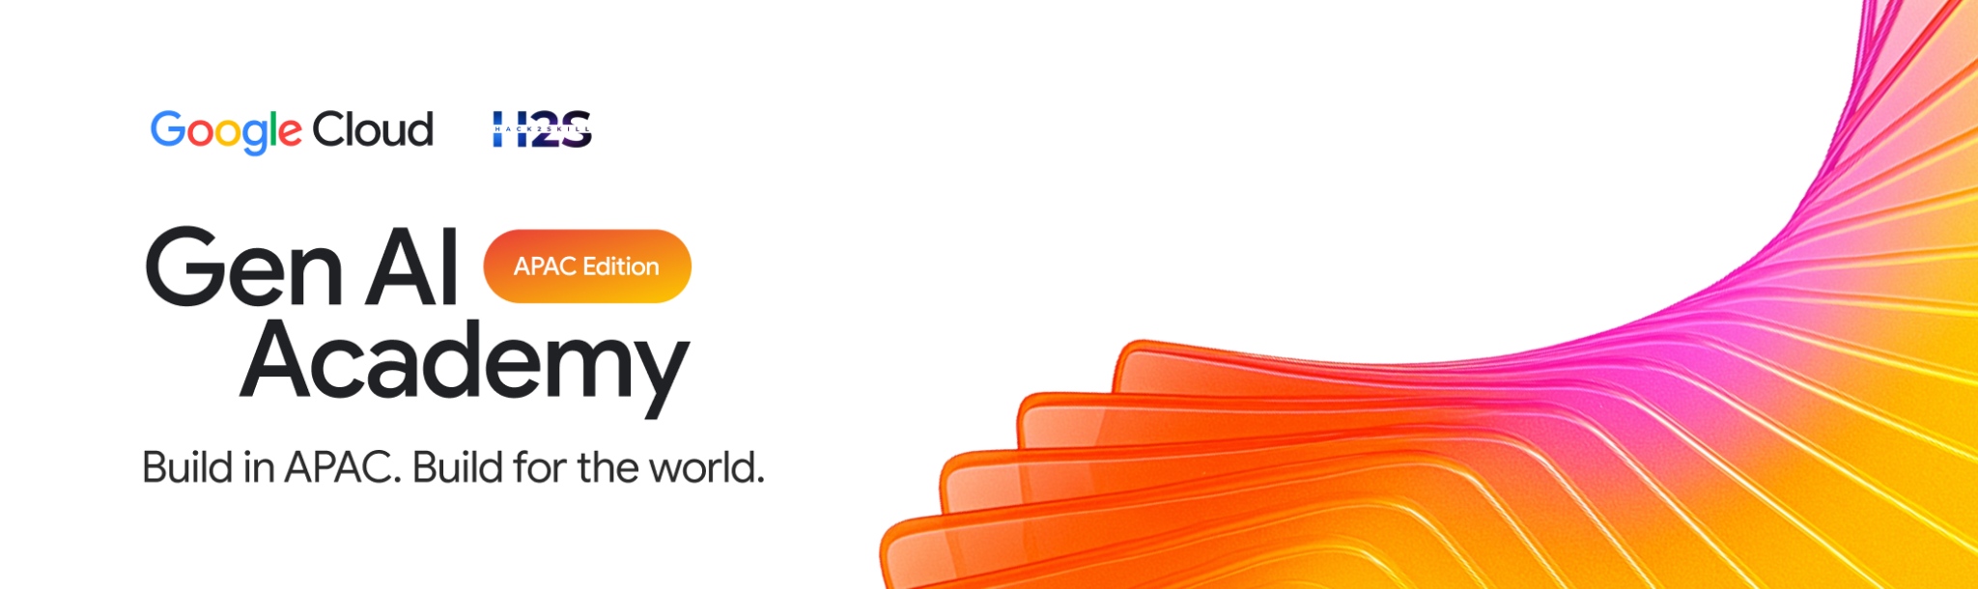
Participant Details
Participant Name:
Bindu Singh M
B Harshavardhan
Problem Statement:AI for Better Living and Smarter Communities

Slide 2
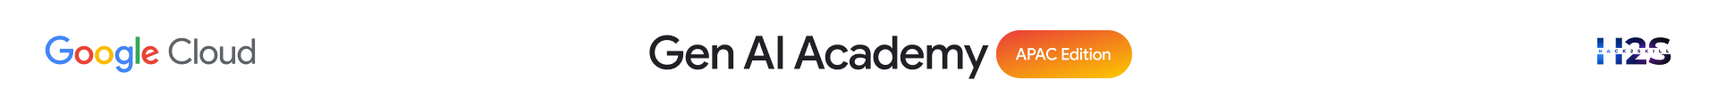
CivicMind AI: Location-Aware Decision Intelligence
The Core Vision is about making cities smarter. It does this by bringing all the different information that cities have, like traffic, air quality, health services and energy use into one place. This makes it easier for people to understand what is going on in the city and make decisions.
Here are the key parts of this system:
It uses a kind of computer system that is good at understanding what people are asking for. This system uses something called google-genai and Gemini 3.5 Flash to figure out what people need and give them answers.
If the internet is not working the system can still function because it has a plan. This backup plan uses a kind of math to make sure that the city can still respond to emergencies.
The Core Vision makes a difference in how cities are managed. It helps people who plan cities and respond to emergencies to do their jobs better. The Core Vision helps them to reduce energy use during peak times make traffic flow better and respond to emergencies faster. The Core Vision is, like a tool that helps cities run smoothly and be better places to live.

Slide 3
Your solution should be able to explain the following:
Type here…
Approach & Tech: Built a "Digital Twin" console using Gemini 2.5 Flash for multimodal visual hazard analysis and structured JSON schema for 5-year policy forecasting.
Problem & Impact: Solves siloed city planning by linking transit, safety, and energy. Cuts emergency response times to 7.2 minutes and optimizes municipal budgets via predictive simulations.
Architecture & Workflow: React + TS frontend visualizing an animated SVG Blueprint Map (live traffic/ambulance loops), powered by Flask/Express servers and GPS-aware routing.

Slide 4
Opportunities
Market and Scalability Opportunities:
This is a match for big cities in the APAC region that are growing fast and starting to use smart city technology.
The Market and Scalability Opportunities of this can be expanded to serve people.
It can serve university campuses or industrial parks or big companies that need help with emergencies and utilities, in the Market and Scalability Opportunities.
How CivicMind AI Differs from Existing Ideas:
CivicMind AI is different because it does things that other smart city dashboards do not do. These dashboards only show what happened in the past. CivicMind AI gives advice on what to do and makes changes, to policies on its own.
One big difference is that CivicMind AI keeps working when the internet is not available. Other tools that use the cloud stop working if the internet connection is lost. CivicMind AI can still work because it can process information on its own.
What Makes CivicMind AI Special:
CivicMind AI has something that no other platform has. It is called Resilient Location-Aware Intelligence. This means it is the system that uses advanced reasoning from Gemini and also has a backup plan. This backup plan uses math to make sure that emergency services and resources can still be sent even if the whole network is down. CivicMind AI never fails to do these things even when everything else is not working.

Slide 5
List of features offered by the solution
Location-Aware AI Consultation: Injects live client GPS coordinates (latitude and longitude arrays) directly into the model’s system instructions, providing hyper-localized, context-specific municipal policy advice.
Resilient Dual-Engine Core: Pairs the advanced contextual reasoning of Gemini 3.5 Flash with an automatic local fallback mechanism.
Deterministic GIS Fallback Engine: Features a math-driven Haversine Matrix Model that instantly calculates physical distances and checks resource availability (like open trauma beds) even when disconnected from the cloud.
Multi-Domain Telemetry Simulators: Ingests and processes active datasets across eight core municipal sectors, including Urban Mobility, Smart Grid Utilities, Environmental Health (AQI), and Public Safety.
Real-Time Predictive Risk Alerting: Generates dynamic risk-assessment maps, bottleneck warnings, and load-shedding projections with explicit verification matrices.
Structured Executive Action Plans: Transforms complex relational arrays into high-clarity Markdown outputs, complete with scannable layout tables, specific policy directives, and structural confidence intervals.

Slide 6
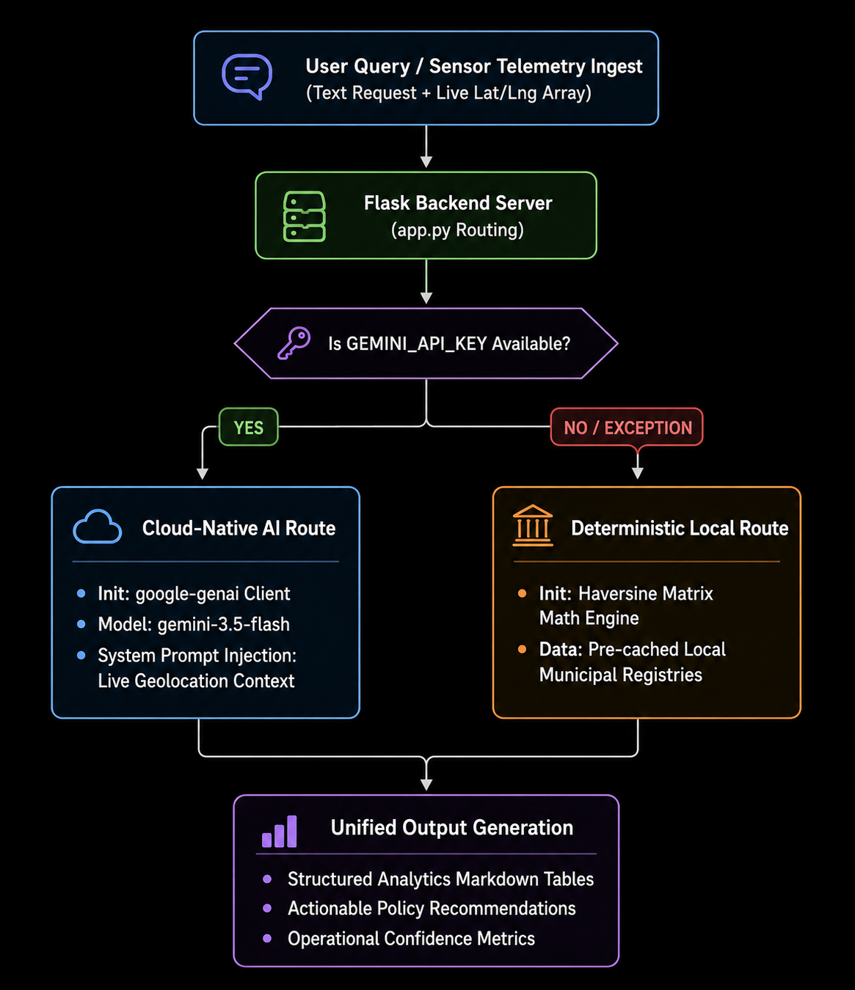
Process flow diagram or Use-case diagram

Slide 7
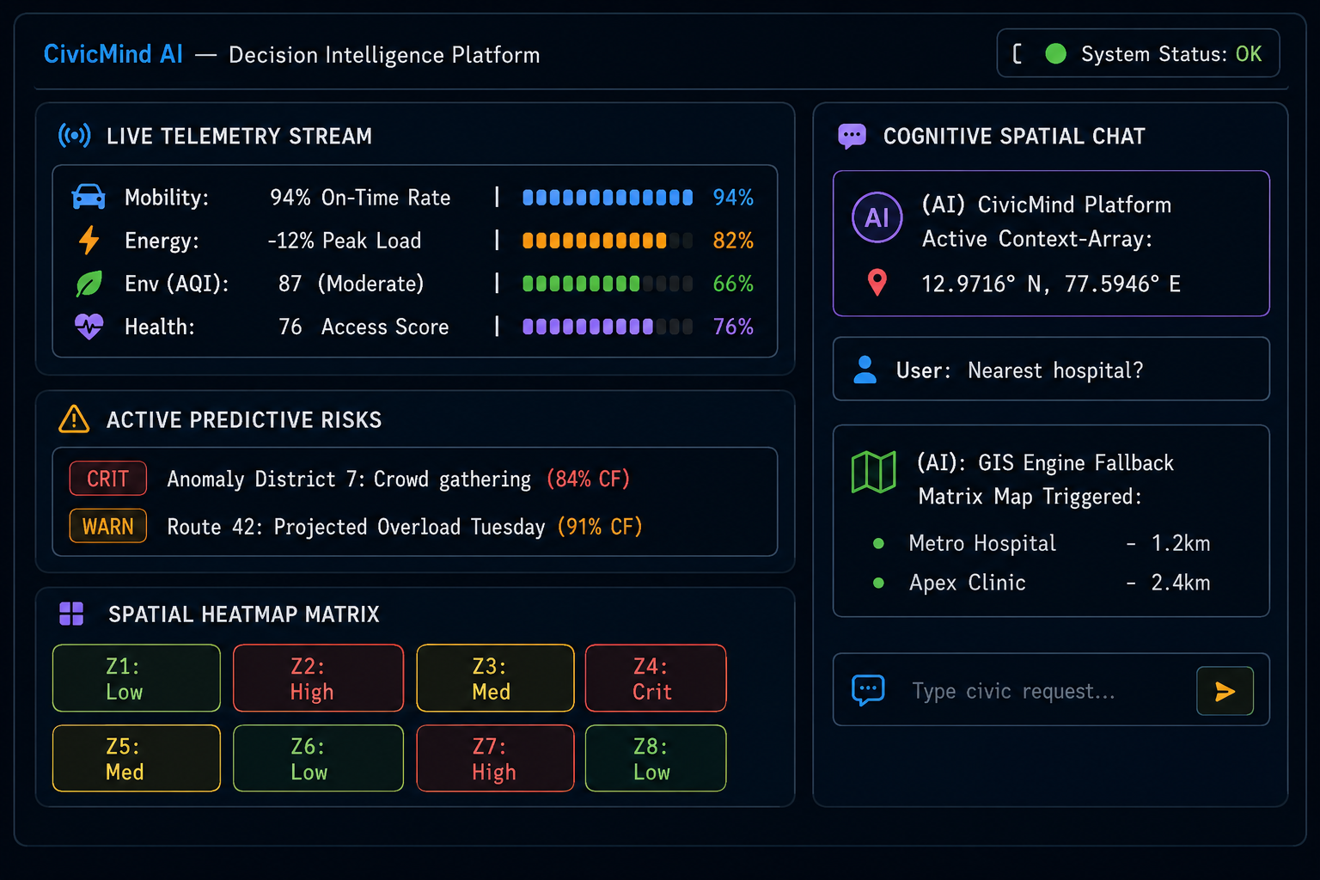
Wireframes/Mock diagrams of the proposed solution

Slide 8
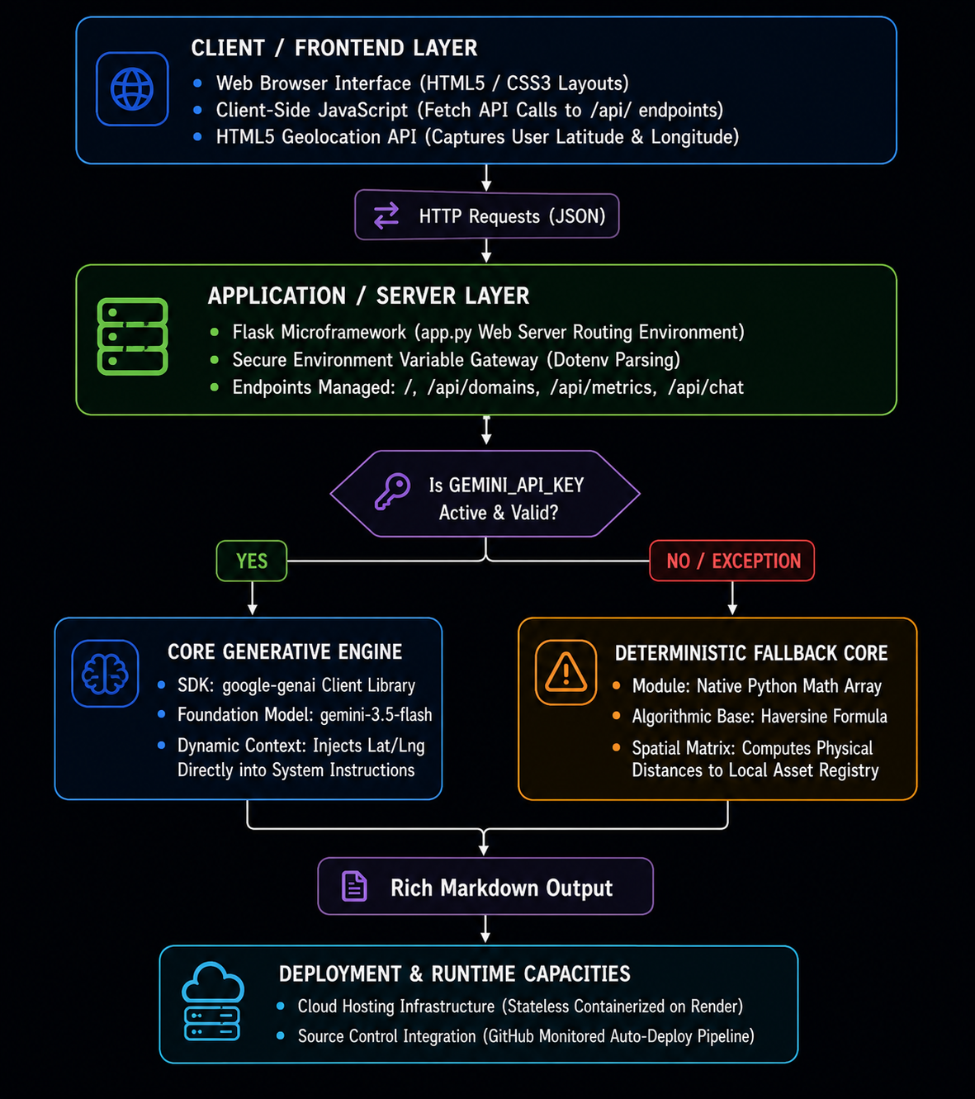
Architecture diagram of the proposed solution:

Slide 9
Technologies / Google / Nvidia Services used in the solution
User Query / Sensor Telemetry Ingest
Flask Backend Server (app.py Routing)
Decision Node: Is GEMINI_API_KEY Available?
YES → Cloud-Native AI Route
Init: google-genai Client
Model: gemini-3.5-flash
System Prompt Injection: Live Geolocation Context
NO / EXCEPTION → Deterministic Local Route
Init: Haversine Matrix | Math Engine
Data: Pre-cached Local Municipal Registries
Unified Output Generation
Structured Analytics Markdown Tables
Actionable Policy Recommendations
Operational Confidence Metrics
Notes:
All solutions must leverage Google Cloud technologies. NVIDIA technologies should be included by teams that have selected the NVIDIA problem statement.

Slide 10
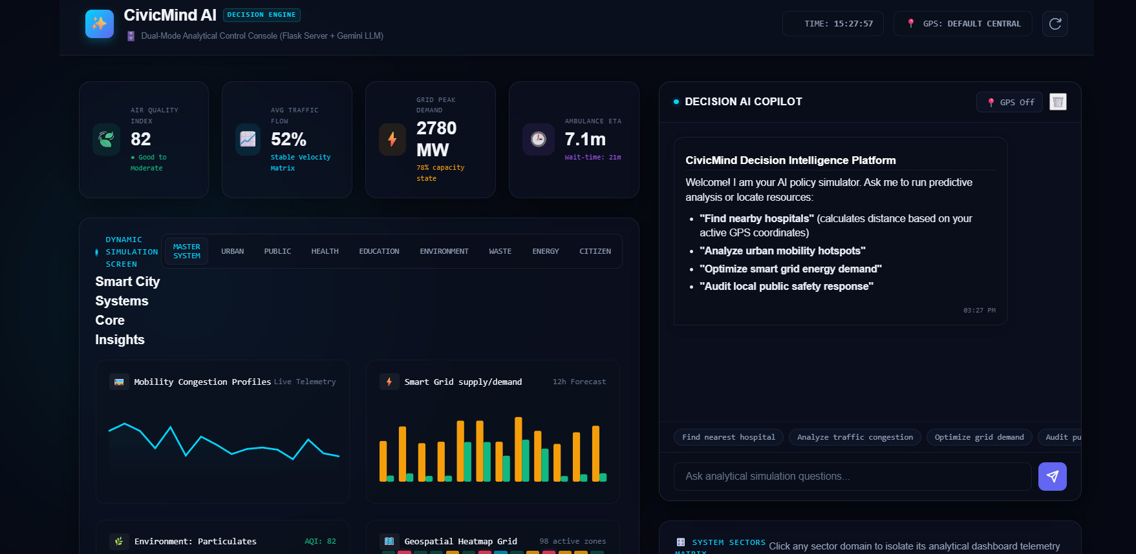
Snapshots of the prototype

Slide 11
Improvements done during prototype refinement phase
Multimodal Upgrades: Integrated image uploads so the AI Copilot can visually analyze street-level incident photos.
Structured Projections: Built a "What-If" sandbox utilizing strict JSON Schema structures for verified 5-year forecasts.
Visual Twin Map: Replaced the static grid with an animated SVG Blueprint map showing live traffic and emergency routes.
Voice Control HUD: Added Web Speech tools for continuous microphone input (STT) and synthesized voice reports (TTS).
Dynamic Telemetry Bindings: Tied scenario sliders directly to the backend, enabling the grid to react dynamically in real-time.

Slide 12
